Slide 1
HOW MUCH IS IT?
Mercari Price Suggestion
Presented by James Seungwon Lee

Slide 2
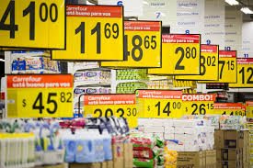
Who I am
I am a data scientist hired by online shopping mall company called ‘Mercari’.
They would like to offer a pricing suggestion service to sellers.
My task is to build a model to predict the sale price of products from its description.
.

Slide 3
What is price?
Price is the amount of money charged
for a product or a service.
In the business world, It Is super important.
Because,
it is what the buyer is willing to pay.
it is what the producer wants to achieve.
Therefore, they must meet in the middle.

Slide 4
So, Price suggestion model can help sellers
Achieve the Sales Increase
Saves a time for Research
No laborforce needed
Knows the market price
Simple
Easy
Notes:
1.Amazon reported a 29% sales increase to $12.83 billion during its second fiscal quarter, up from $9.9 billion during the same time last year. (in 2018)
How much is New product? In conclusion : just upload it and we will save your money and time!!!

Slide 5

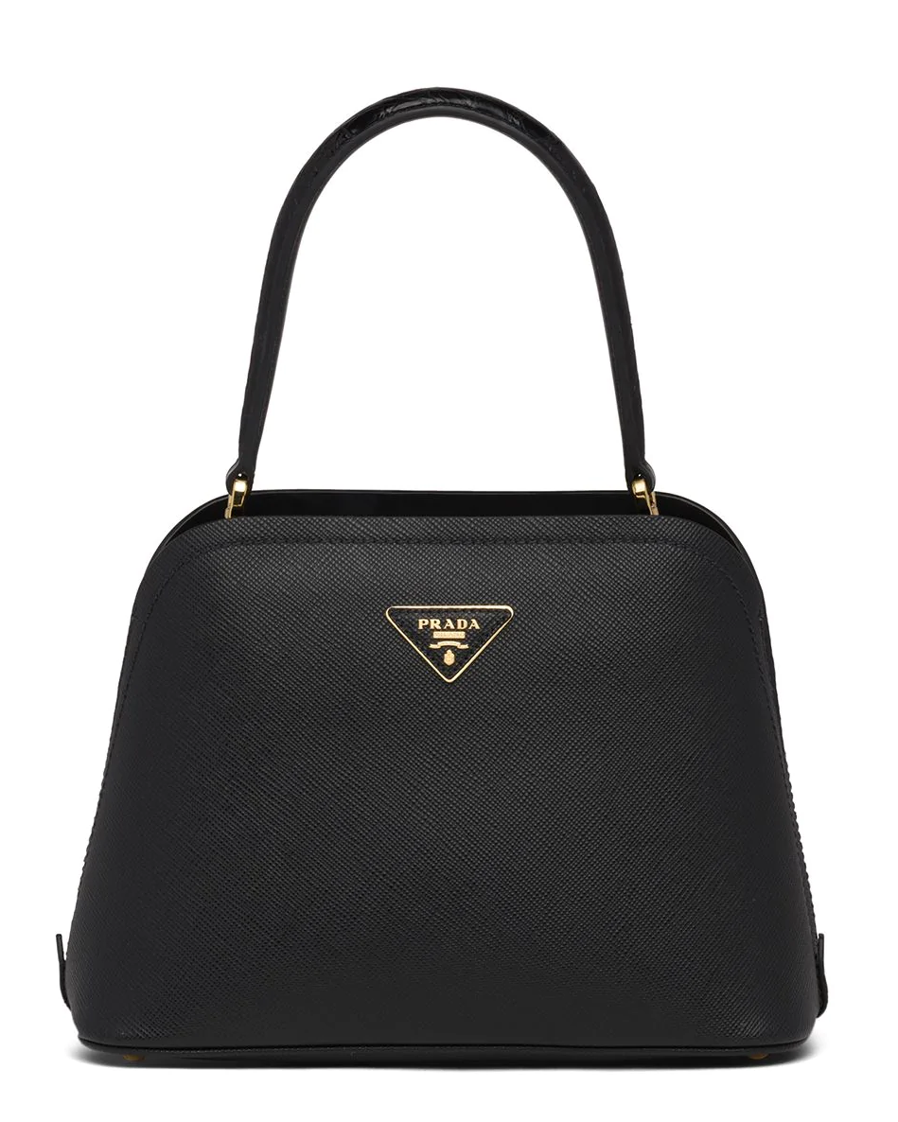
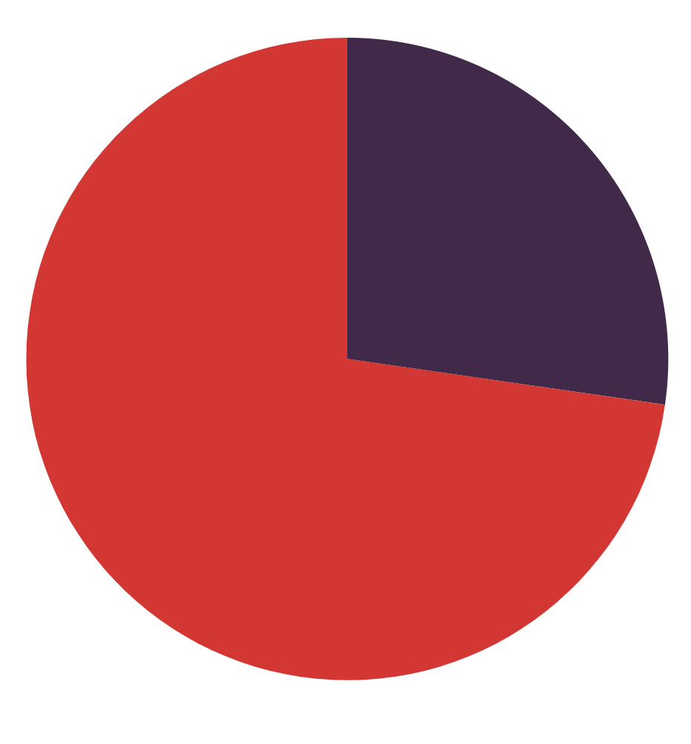
QUIZ) Which one looks more expensive? Guess?
EARTH
MARS
VS

Slide 6
What if I give you information, would it be easier?
EARTH
MARS
VS
100% Crocodile Leather
One size
Single Hand tote bag
100% Crocodile (Inside) and Calf Leather (Outside)
2020 New Edition
Single Hand tote bag
Notes:
Was it easy to guess the price? this is tough. Isnt it? Does the words description any mean to you?

Slide 7
Price Suggestion model with NLP(Natural Language Processing) Techniques
NLP deals with the integration between computers and human language. (ex. Quiz)
I applied NLP techniques and built a best model to predict the price.
With NLP
Without nlp
Notes:
There are many pricing method like break-even or cost plus etc . But in this project , I will be using NLP techniques for this.

Slide 8
Models
Baseline:
Ridge Regression:
CV Elastic Net
Light GBM
To test the impact of our NLP features, we ran an additional Ridge regression that didn’t include any of our generated NLP features.
Chosen to counter the effects of multicollinearity between our NLP features while being both efficient and interpretable.
Chosen to explore the trade-off between L1 and L2 regularization and test for potential improvements over our ridge regression.
Chosen as our boosting algorithm of choice due to its perceived speed advantages over XGBoost and scikit’s GBM.

Slide 9

Finding
DESKTOP WEB
You can replace the image on the screen with your own work. Just delete this one, add yours and send it to the back

Slide 10
Recommendation AND conclusion
VECTOR
Flat design new year background
Illustration concept with multiple languages conversations
Flat design christmas background
Flat design of cyber monday with people and gifts
Flat sale landing page template
Flat design of black friday with people
PHOTO
Clothing store with mannequins
Close-up of waitress serving chocolate cake with whipped cream
ICON
Shopping center

Slide 11

THANKS YOU
Do you have any questions?
Please keep this slide for attribution

